Slide 1

Affect and Action: Exploring Gamer Responses to Climate Questions in Mobile Games
Presenter: Victor Chinua Ene
Student ID: 2318217
Course: M.Sc. Data Analytics and Technologies
Date: January 2026
Supervised by: Dr. Anchal Garg

Slide 2
Background & Context
The Climate Communication Challenge
Digital Games as Solutions
Global temperatures reached highest levels in 100,000+ years (2023)
Traditional engagement methods face declining trust and participation
3 billion+ gamers worldwide indicating massive reach potential
Interactive and immersive engagement format
Effective for complex systems and narratives
Enable organic expression within gameplay
The GREAT Project (2023-2026): Horizon Europe-funded initiative exploring games as environments for civic discussion on sustainability, integrating policy-relevant questions into commercial gameplay.

Slide 3
Prior Research & Major Addition
Prior Research Established
Hollins et al. (2023, 2024) validated in-game climate surveys: 58% engagement, 84% completion in SMITE
BUT: No analysis of open-ended text content
Carman et al. (2024) - Yale survey (n=2,000+ US gamers) showed gamers engage with climate issues
BUT: US-only, self-reported behaviour, no actual text response analysis
This Study's Major Addition
Hansen & Świderska (2024) - Identified value of open-ended survey responses for capturing nuanced views
Sentiment analysis (VADER, TextBlob)
Thematic discourse analysis
BUT: US-only, self-report Doesn't address gaming contexts, focused on traditional surveys

Slide 4
The Research Gap
Critical Missing Analysis
Despite almost one million players engaging with Play2Act2 from 228 countries, thousands of open-ended text responses remain unanalysed, leaving authentic citizen voices and emotional expressions unexamined. What players actually say and how demographics shape responses remained unknown
What's Missing from Existing Research
Limited Scope
Structural Limits
Policy Gap
Research fragmented, focused on design principles and small-scale evaluations
Closed-ended formats can't capture spontaneous framing or authentic emotional expression
Governments lack systematic ways to access citizen priorities and emotional responses

Slide 5
Objectives
1. To assess participation in qualitative text response examining whether engagement varies by gender, age, or education.
2. To apply sentiment analysis tools to classify English-language responses, examining whether sentiments differ significantly across demographic groups
3. To examine emotional tones expressed in responses by coding specific affective expressions.
4. To identify salient thematic content in English-language responses.

Slide 6
Methodology
1. Data Collection
2. Preprocessing
In-game survey (Dec 2023 - Mar 2024)
Text cleaning & detection
76,175 sessions, 228 countries
4 open-ended questions
Lingua-py language detection
Cleaning and Data
3. Sentiment Analysis
4. Thematic Coding
VADER TextBlob
N grams - NVivo Qualitative analysis
Automated classification
Polarity scores
Theory-driven framework
Manual coding + n-grams

Slide 7
Key Finding 1: Engagement Patterns
Q4: CLIMATE FEELINGS
Q5: DAILY LIFE CHANGES
Q9 & Q10
4.4%
3.8%
<0.1%
3,338 responses
2,893 responses
Minimal responses
Strong Completion Among Engaged Players
97.6% of participants who responded to Q4 completed the entire survey.
Q4 → Q5 Continuation Pattern
76.6% of Q4 respondents continued to answer Q5, with longer responses in Q4 (mean: 9.3 words), Q5 (mean: 6.8 words)
Highest
Lowest
Difference
22.6%
8.9%
13.7pp
Still in education
Never went to school
Gap magnitude

Slide 8
Key Finding 2: Sentiment Analysis
Overall Sentiment Distribution (VADER)
43% Neutral
42% Positive
15% Negative
Age: Strongest Demographic Predictor
Kruskal-Wallis tests revealed age as the strongest predictor of sentiment scores (H = 64.65, p < 0.001), with younger participants expressing significantly more positive affect than older age groups. Gender and education showed modest but significant effects.
VADER vs TextBlob Agreement
Key Insight
72.3%
Gaming platforms may attract participants more receptive to climate messaging, or gameplay context primes positive engagement
Both tools agreed on sentiment classification

Slide 9
Key Finding 3: Thematic Patterns
Dominant Themes in Player Responses
REPORTED GAME EFFECT
BEHAVIOURAL RESPONSE
47.7%
31.8%
Awareness-Raising
Recycling Focus
Dominant theme: heightened awareness and knowledge about environmental issues
Most mentioned behavior, reflecting accessibility of recycling
Awareness-Action Tension
Findings reveal gap between awareness generation (dominant outcome) and behavioural change, highlighting need for interventions bridging knowledge and action.

Slide 10
Demographic Patterns Summary
Age
Strongest sentiment predictor — younger participants express more positive affect, older participants show more complex emotional responses
Education
Strongest engagement predictor — "Still in education": 22.6% response rate vs 8.9% for "Never attended" (13.7pp gap)
Gender
Modest but significant effects — females and non-binary participants wrote longer, more detailed responses
Design must account for demographic variation to maximize inclusive engagement

Slide 11
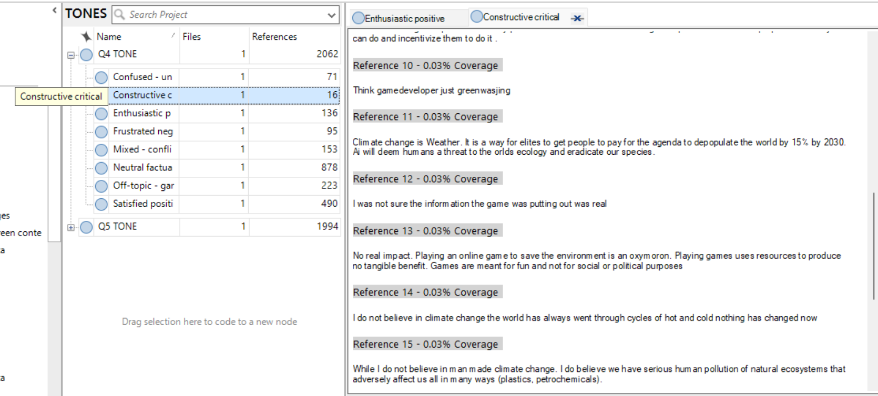
Tones
Focus: Analysis concentrates on Q4 and Q5 due to substantially higher response rates

Slide 12
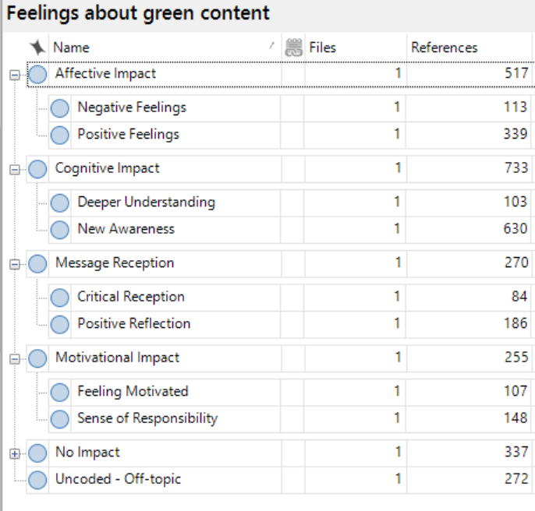
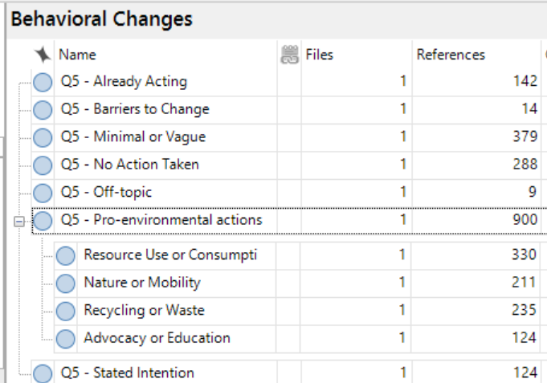
Themes

Slide 13
Conclusions
Gaming platforms enable climate discourse at scale (76K sessions, 228 countries)
Neutral-positive sentiment dominates (85%), challenging doom narratives
Awareness-action gap identified: 47.7% awareness, limited behavior change
Demographics matter: Education strongest predictor of engagement
English only data for sentiment and theme analysis
Single Coder Bias for NVIVO analysis recommend intercoder reliability
Bridging awareness and action remains the critical challenge for climate communication in gaming

Slide 14
References
Carman, J.P. et al. (2024) “Geeks versus climate change: understanding American video gamers’ engagement with global warming,” Climatic Change, 177(6), p. 85. Available at: https://doi.org/10.1007/s10584-024-03747-w.
Hansen, K. and Świderska, A. (2023) “Integrating open- and closed-ended questions on attitudes towards outgroups with different methods of text analysis,” Behavior Research Methods, 56(5), pp. 4802–4822. Available at: https://doi.org/10.3758/s13428-023-02218-x.
Harris, R. et al. (2025) “Play2Act2 Case Study Report.” Zenodo. Available at: https://doi.org/10.5281/zenodo.17955516.
Hollins, P. (2023) “The Application of Games to Engage Citizens in Climate Change Policy Development .” Zenodo. Available at: https://doi.org/10.34190/ecgbl.17.1.1890.
Hollins, P. et al. (2023) “The Games Realising Effective & Affective Transformation (GREAT) Project – A pathway to sustainable impact on climate change policy .” Zenodo. Available at: https://doi.org/10.5281/zenodo.7802446.
Yau, J. et al. (2025) “The Reach of Digital Games and Their Potential as Global Communication Tools,” European Conference on Games Based Learning, 19, pp. 910–917. Available at: https://doi.org/10.34190/ecgbl.19.2.3874.

Slide 15

Thank You
Questions and Discussion

